Slide 1
Integration results

Slide 2
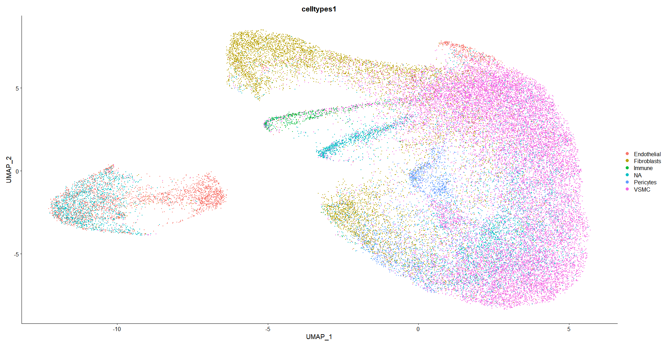
Integrated celltypes allocated per sample

Slide 3
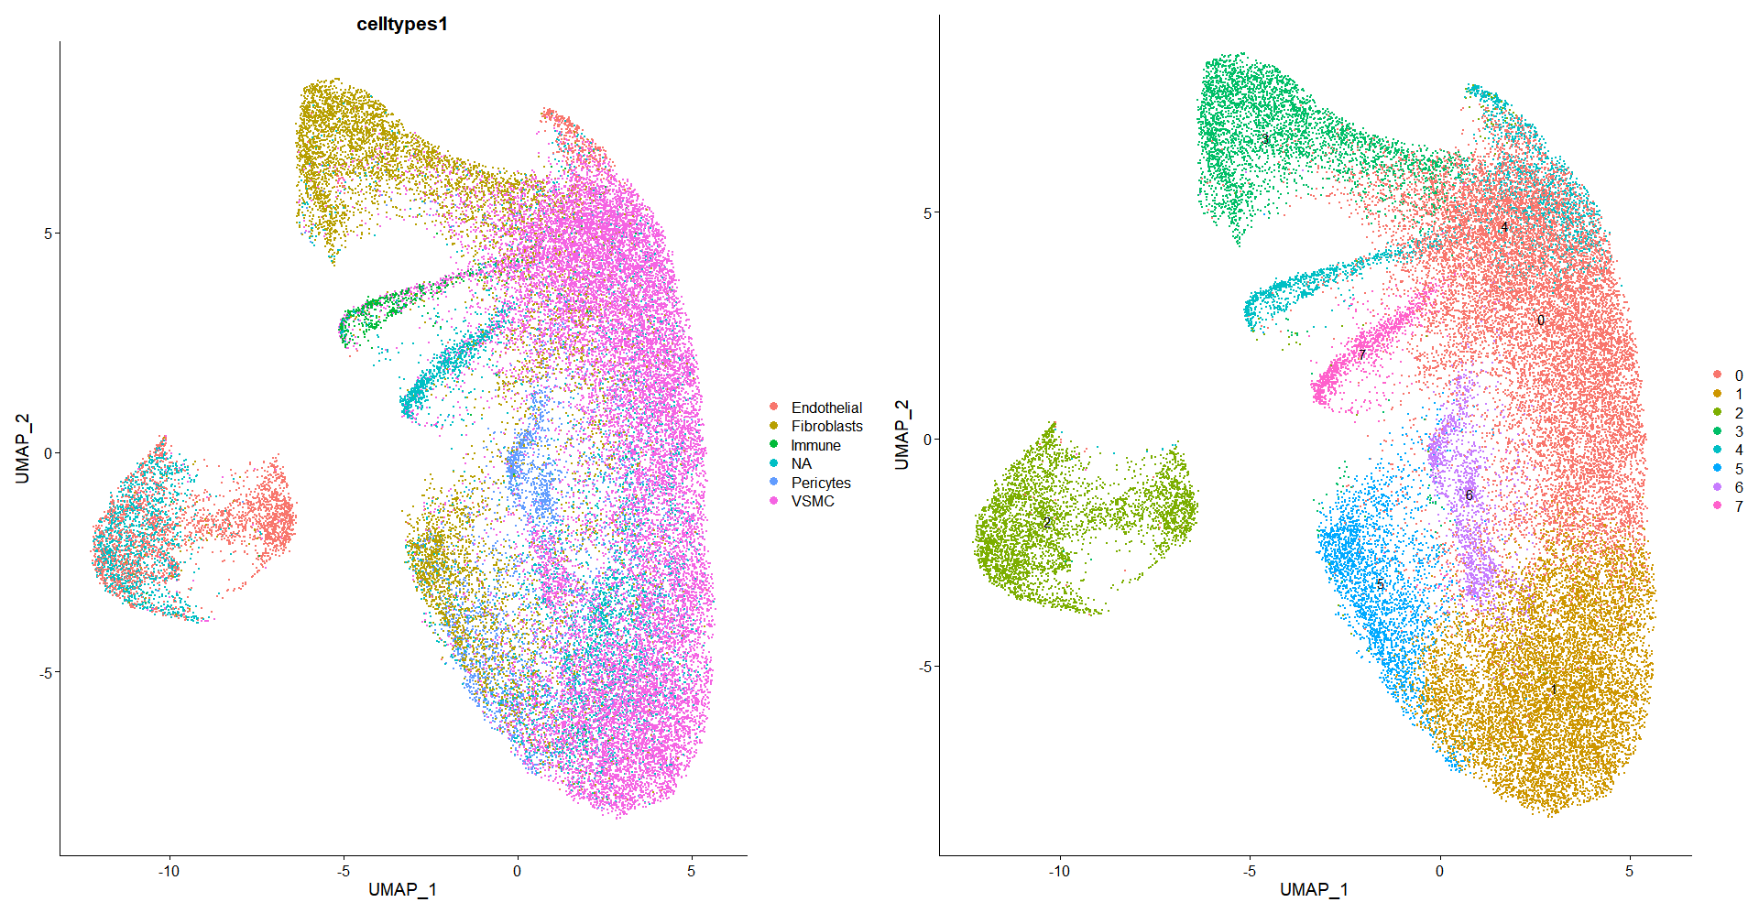
0-VSMC
1-VSMC
2-Endothelial
3-Fibroblasts
4-Immune
5-Fibroblasts
6-Pericytes
7-Unknown

Slide 4
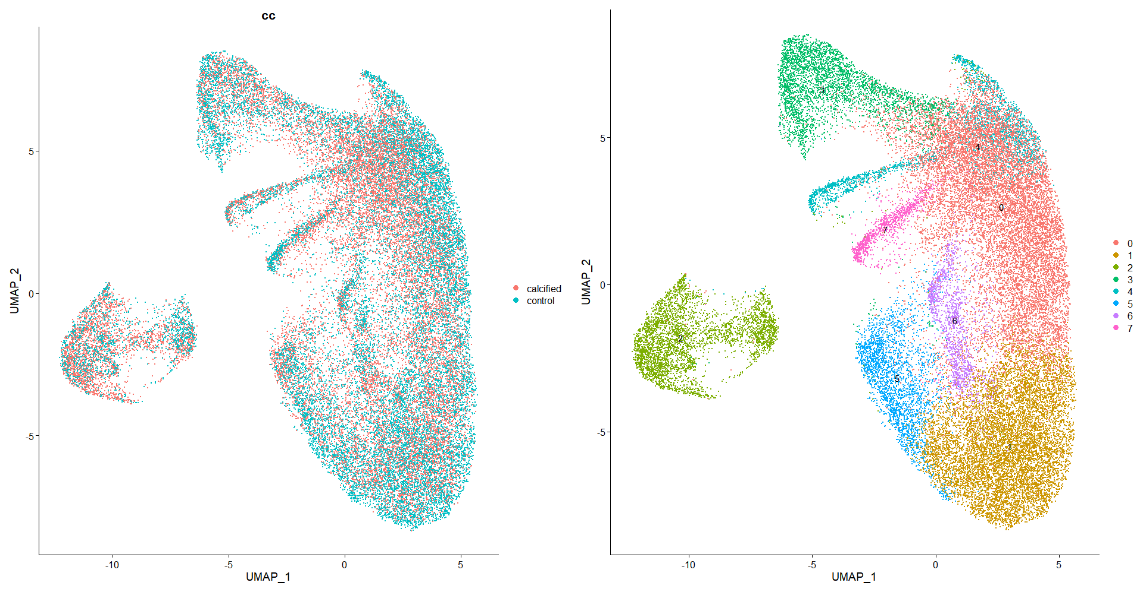

Slide 5
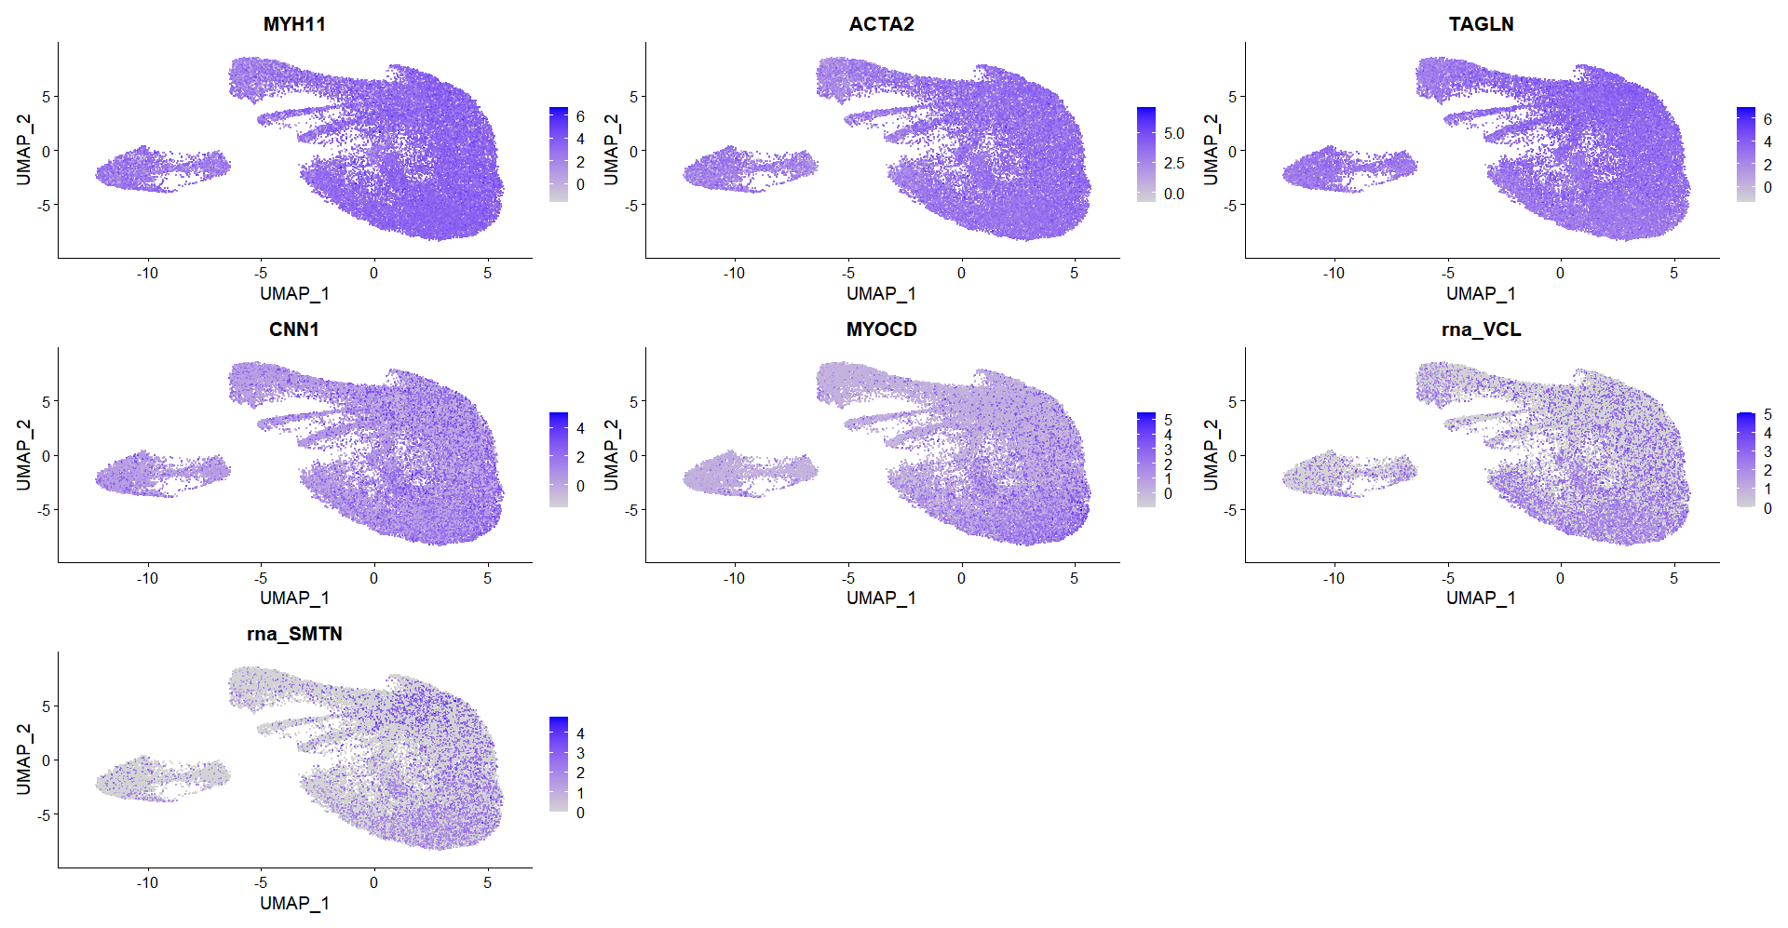
VSMC markers

Slide 6
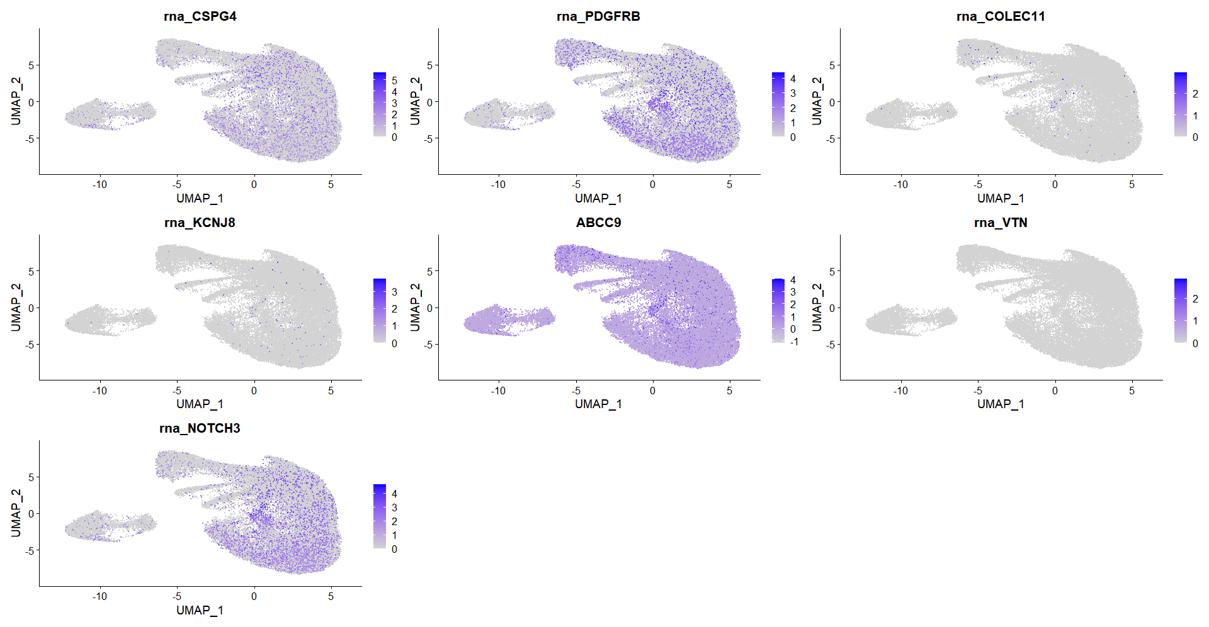
Pericyte markers

Slide 7
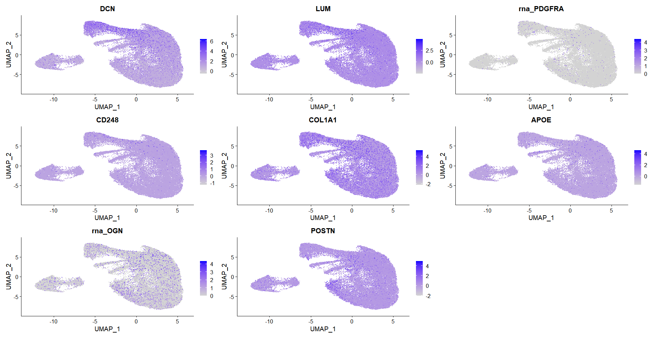
Fibroblast markers

Slide 8
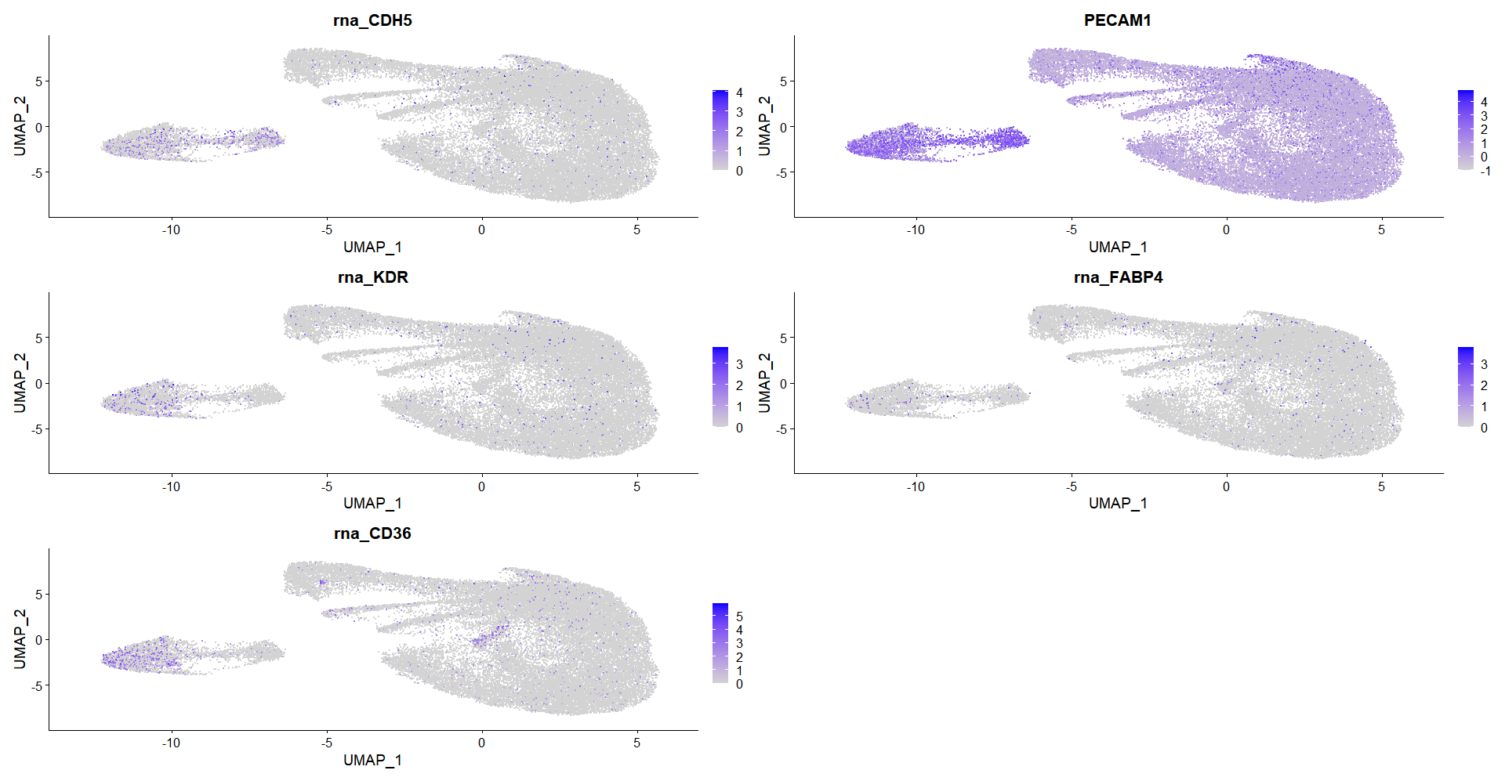
Endothelial markers

Slide 9
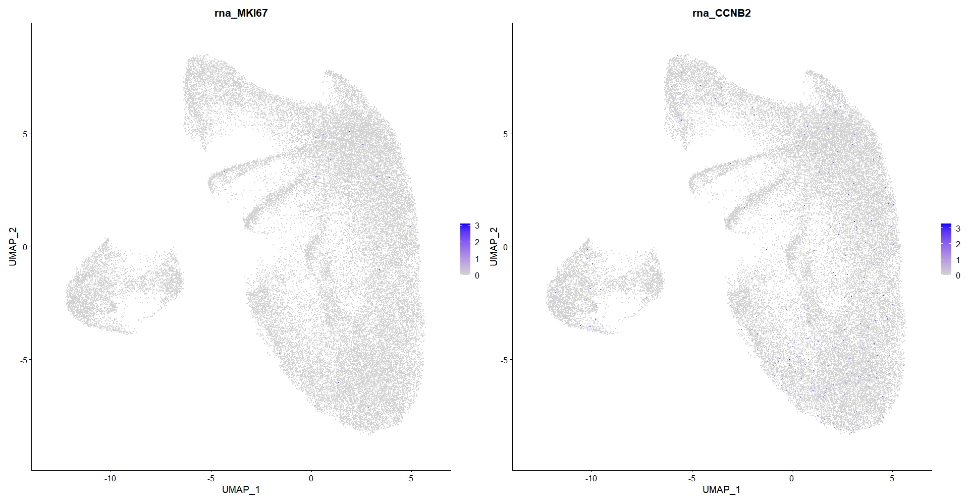
Cellcycle markers

Slide 10
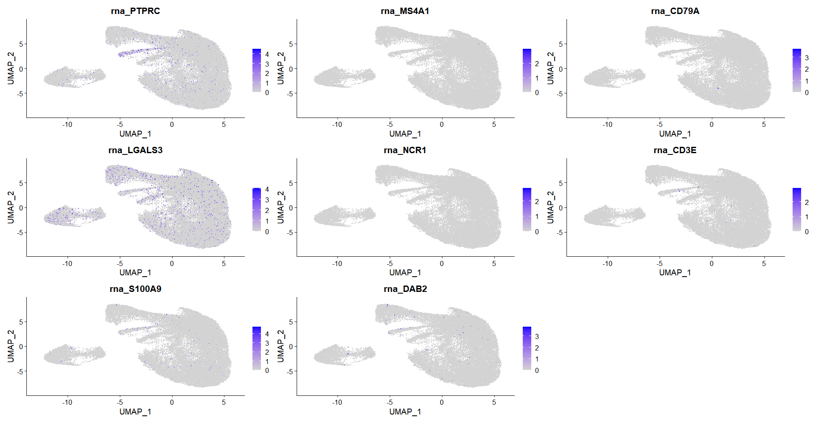
Immune markers

Slide 11
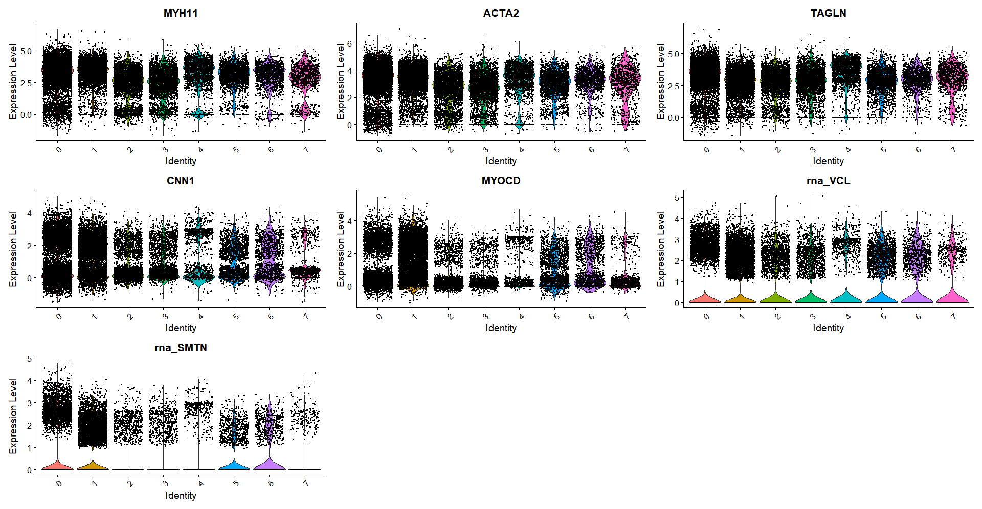
VSMC markers

Slide 12
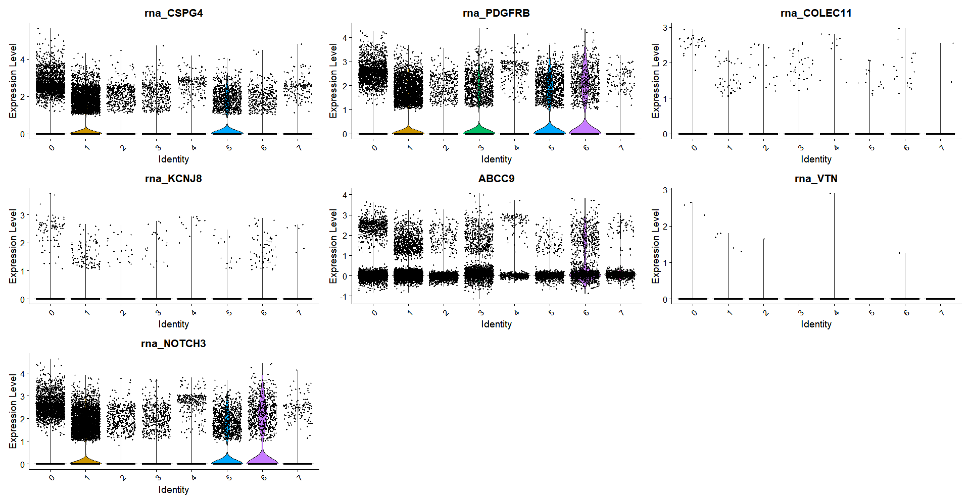
Pericyte markers

Slide 13
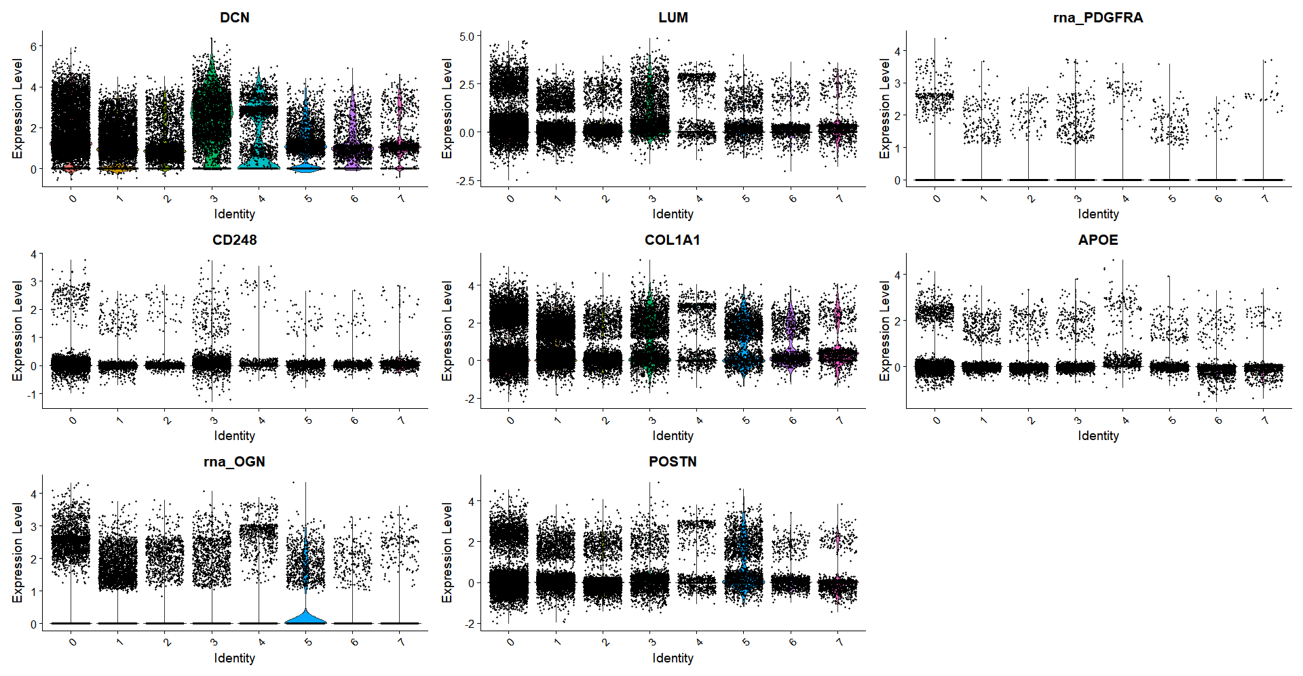
Fibroblast markers

Slide 14
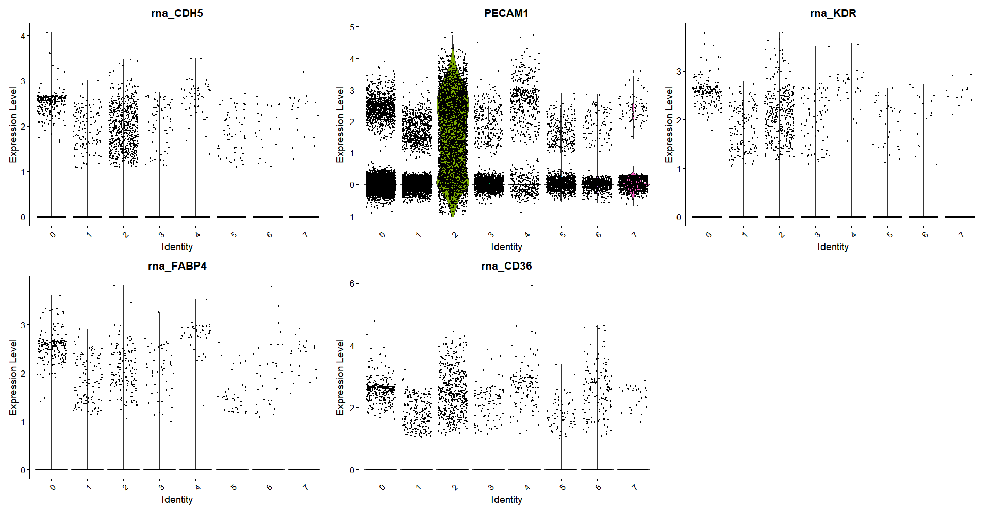
Endothelial markers

Slide 15
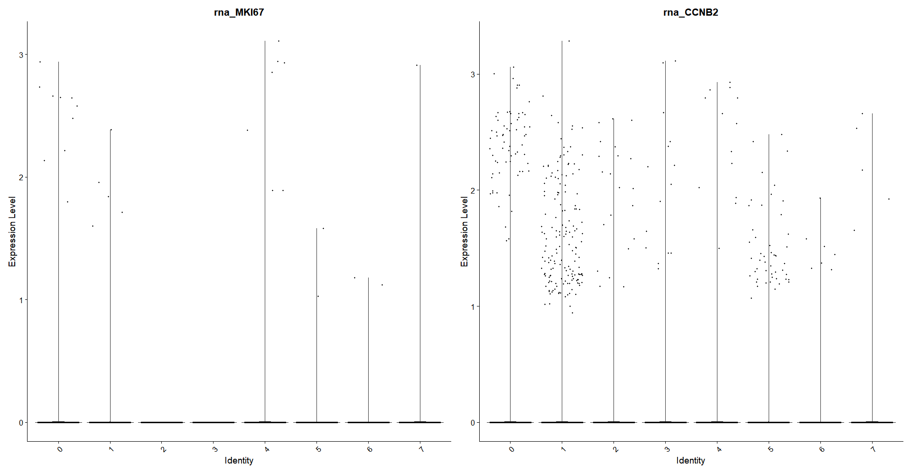
Cellcycle markers

Slide 16
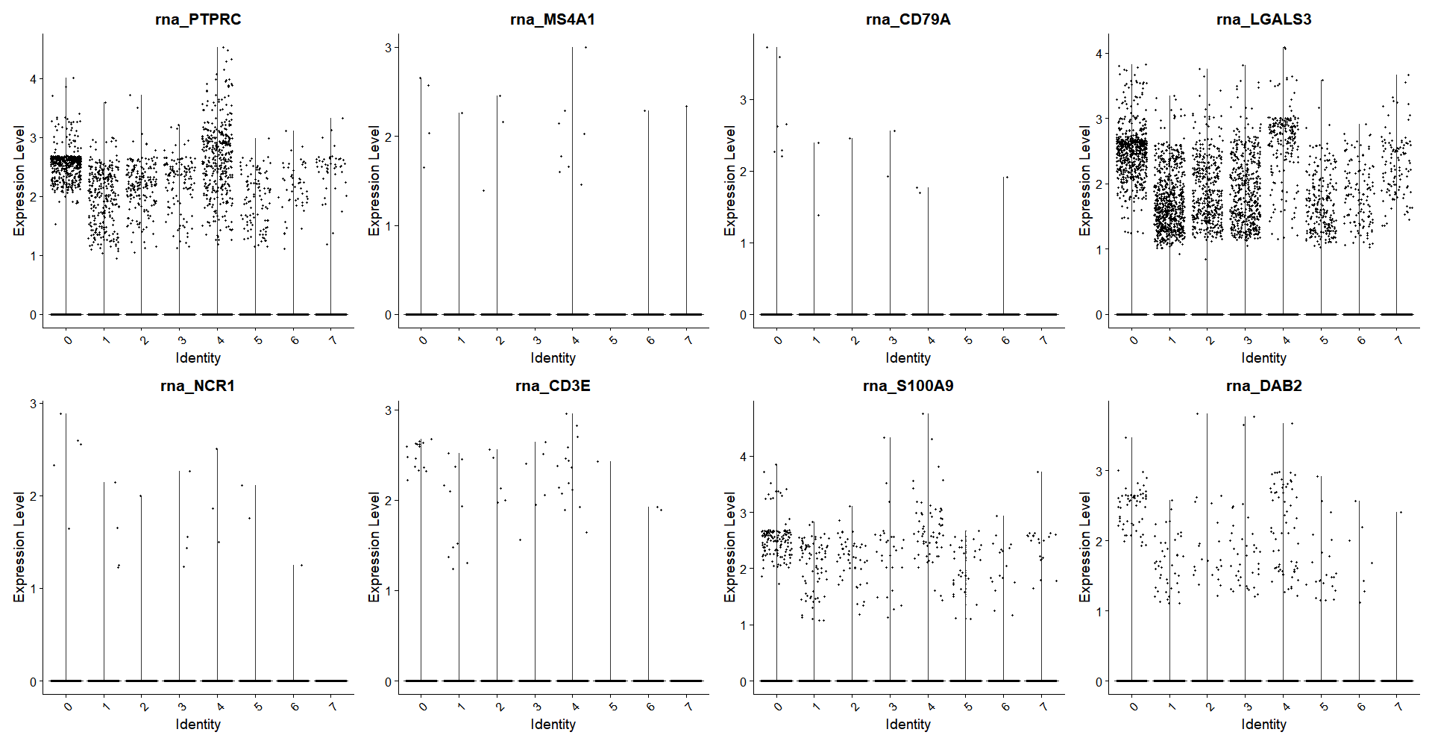
Immune markers

Slide 17
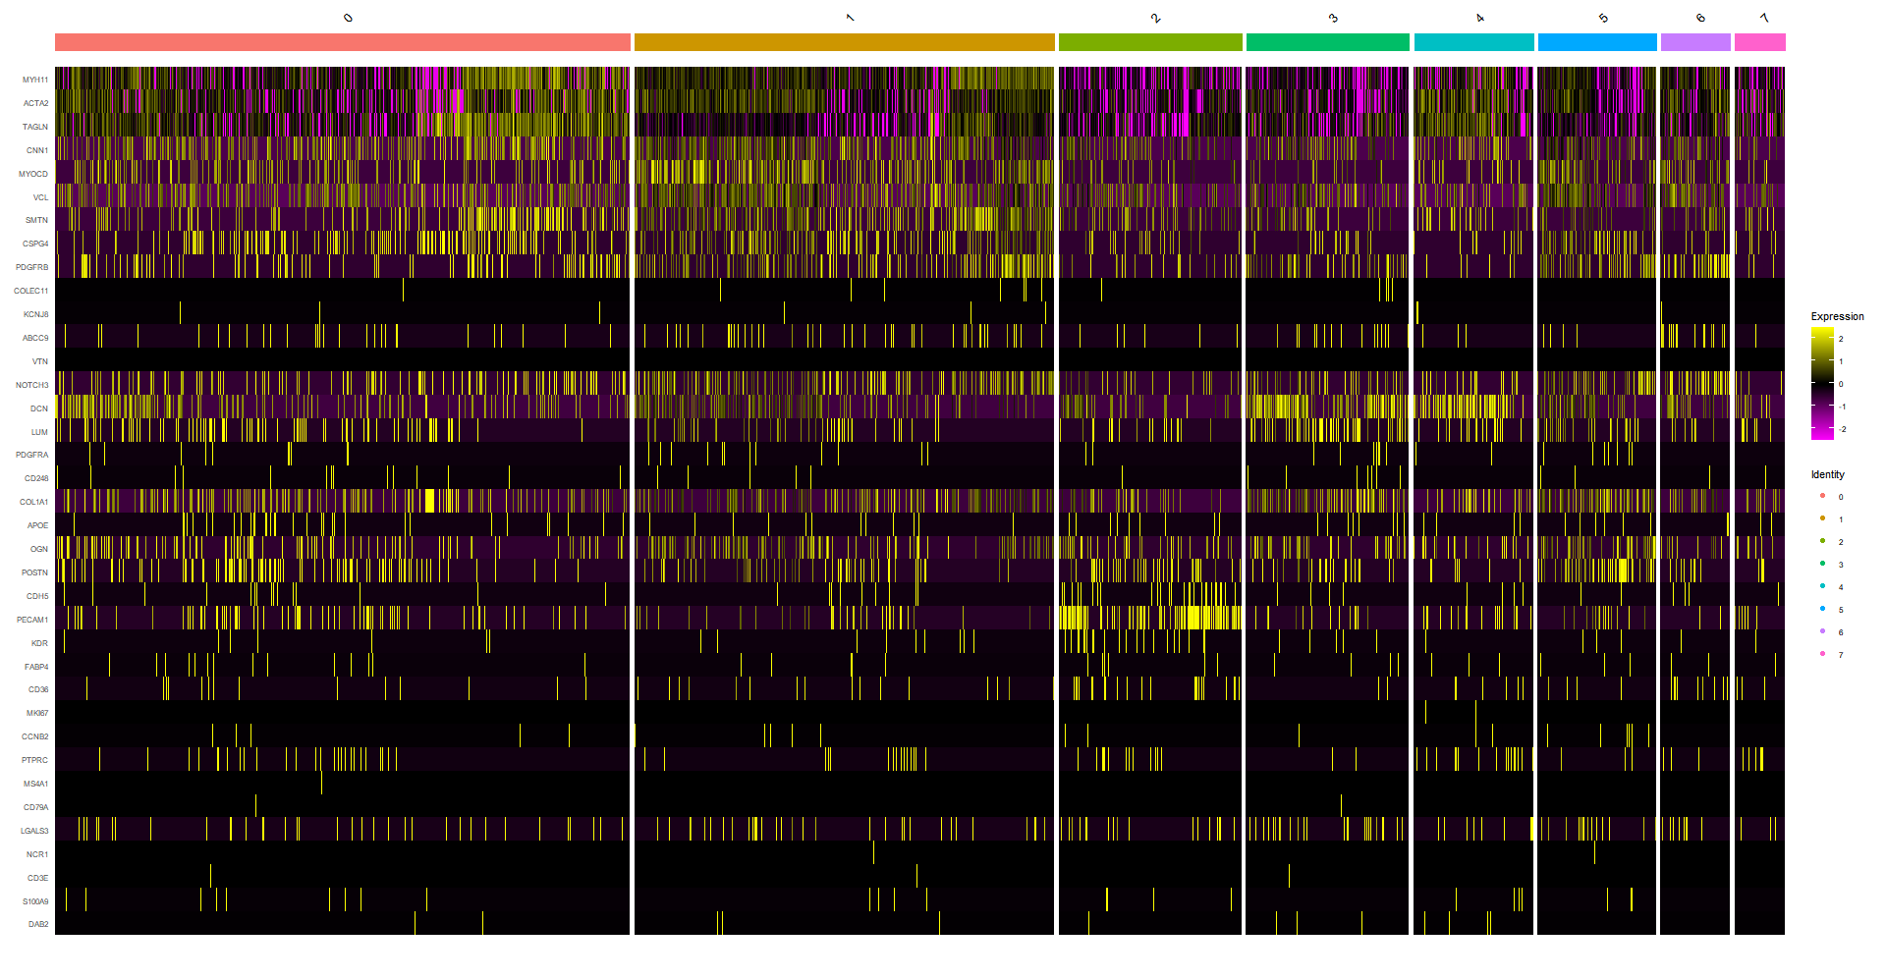

Slide 18
Differential expression
Calcified vs controls

Slide 19
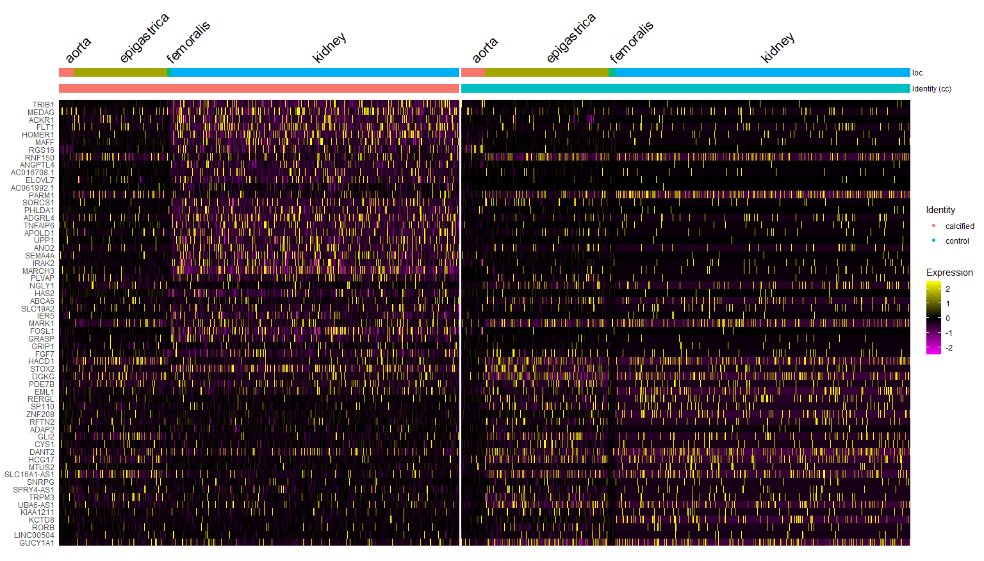
Top 10 DE genes (calcified vs control) per cluster

Slide 20
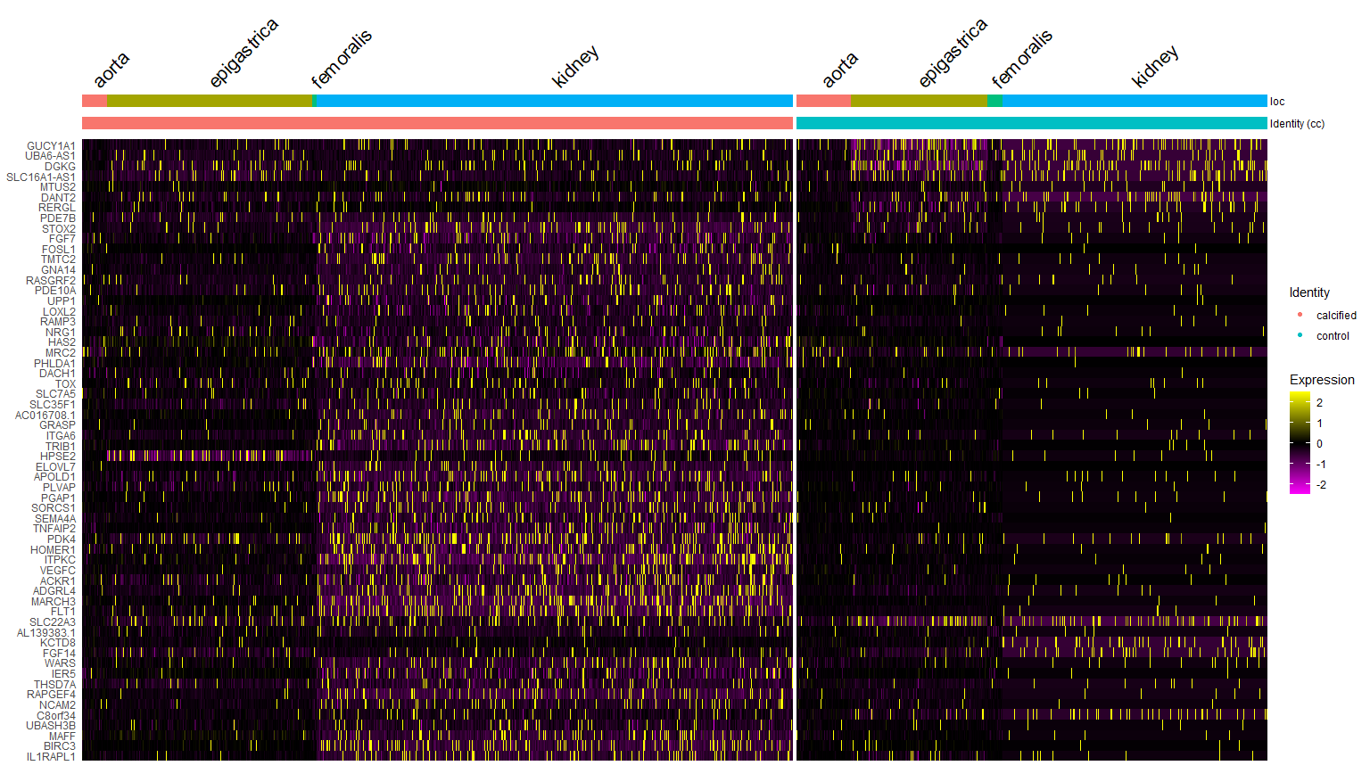
Top 60 DE genes (calcified vs control) – cluster 0

Slide 21
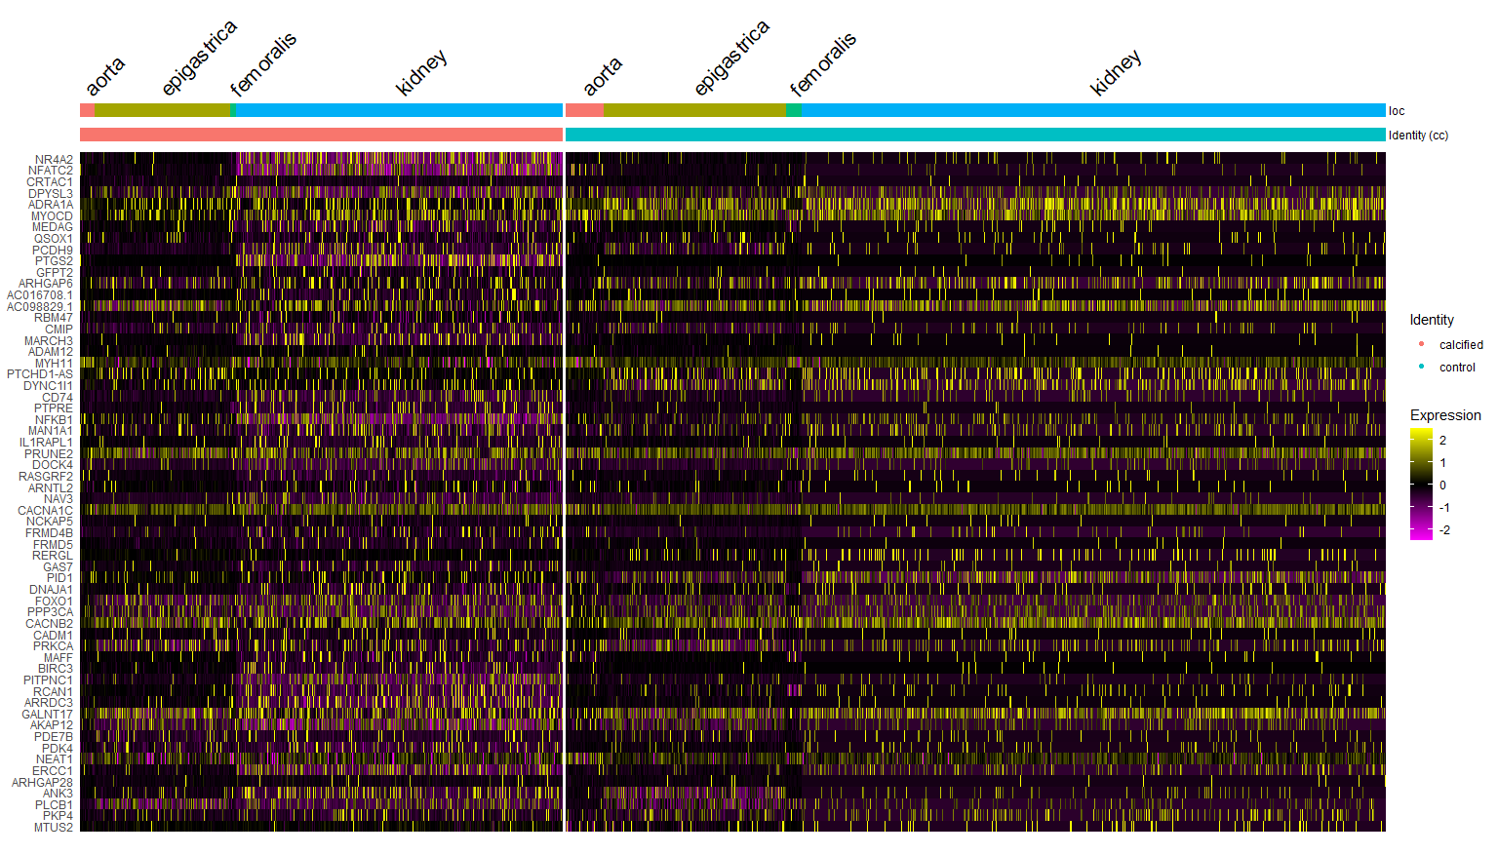
Top 60 DE genes (calcified vs control) – cluster 1

Slide 22
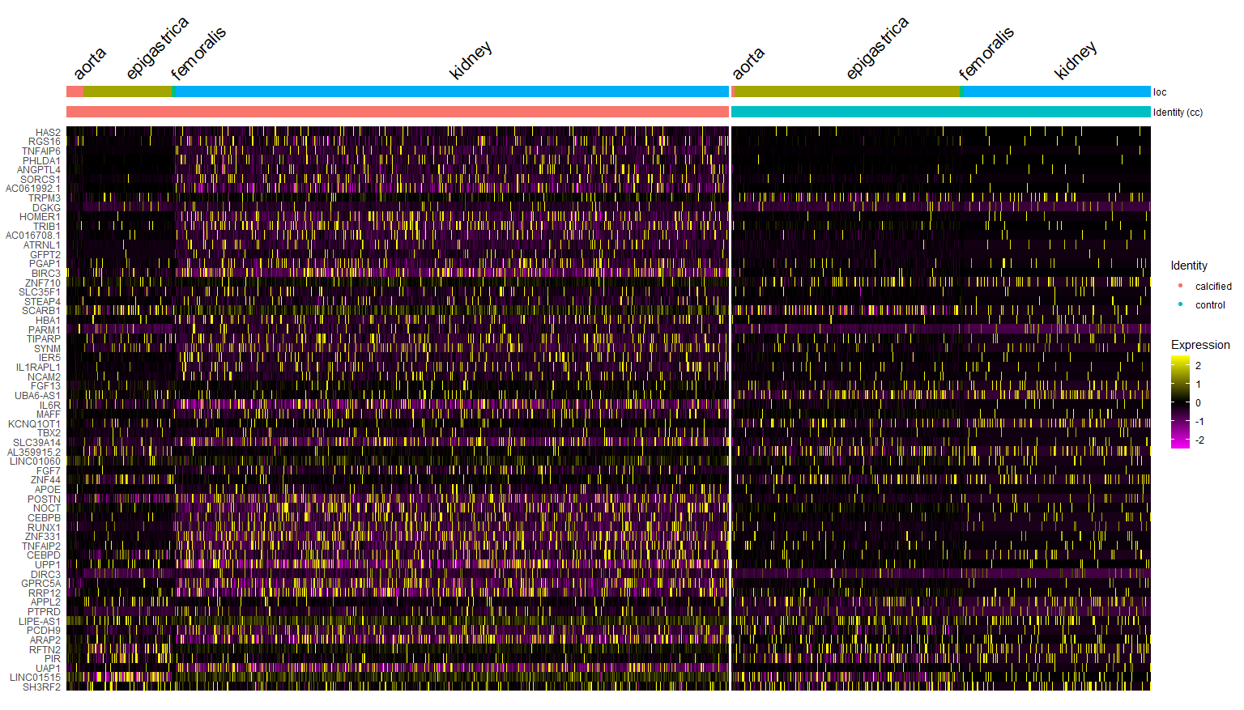
Top 60 DE genes (calcified vs control) – cluster 2

Slide 23
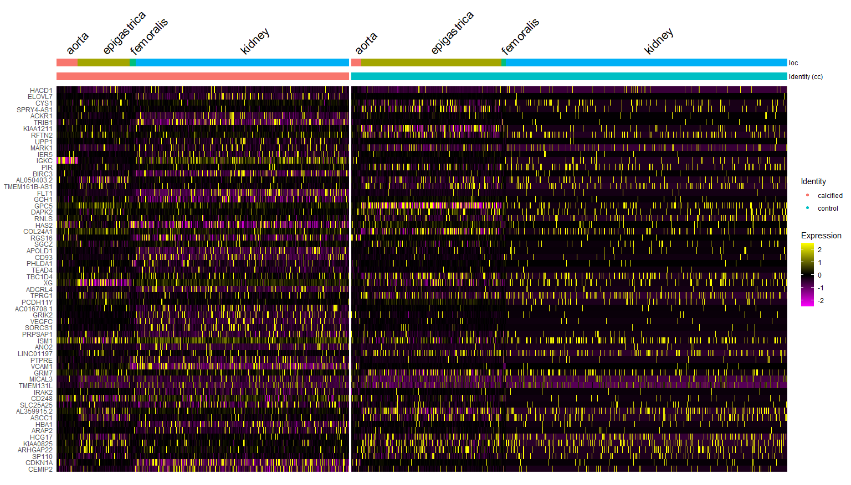
Top 60 DE genes (calcified vs control) – cluster 3

Slide 24
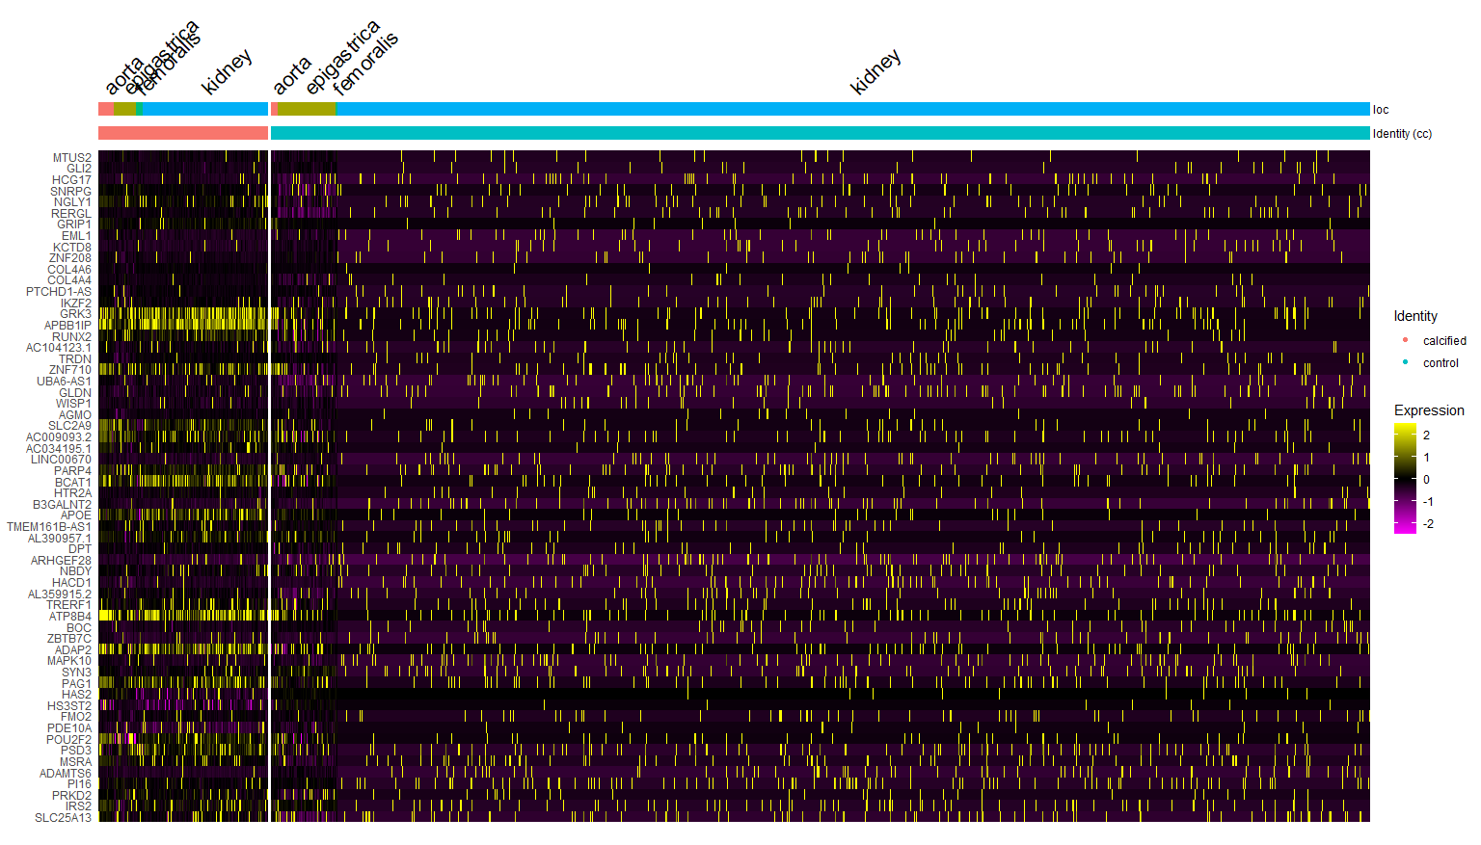
Top 60 DE genes (calcified vs control) – cluster 4

Slide 25
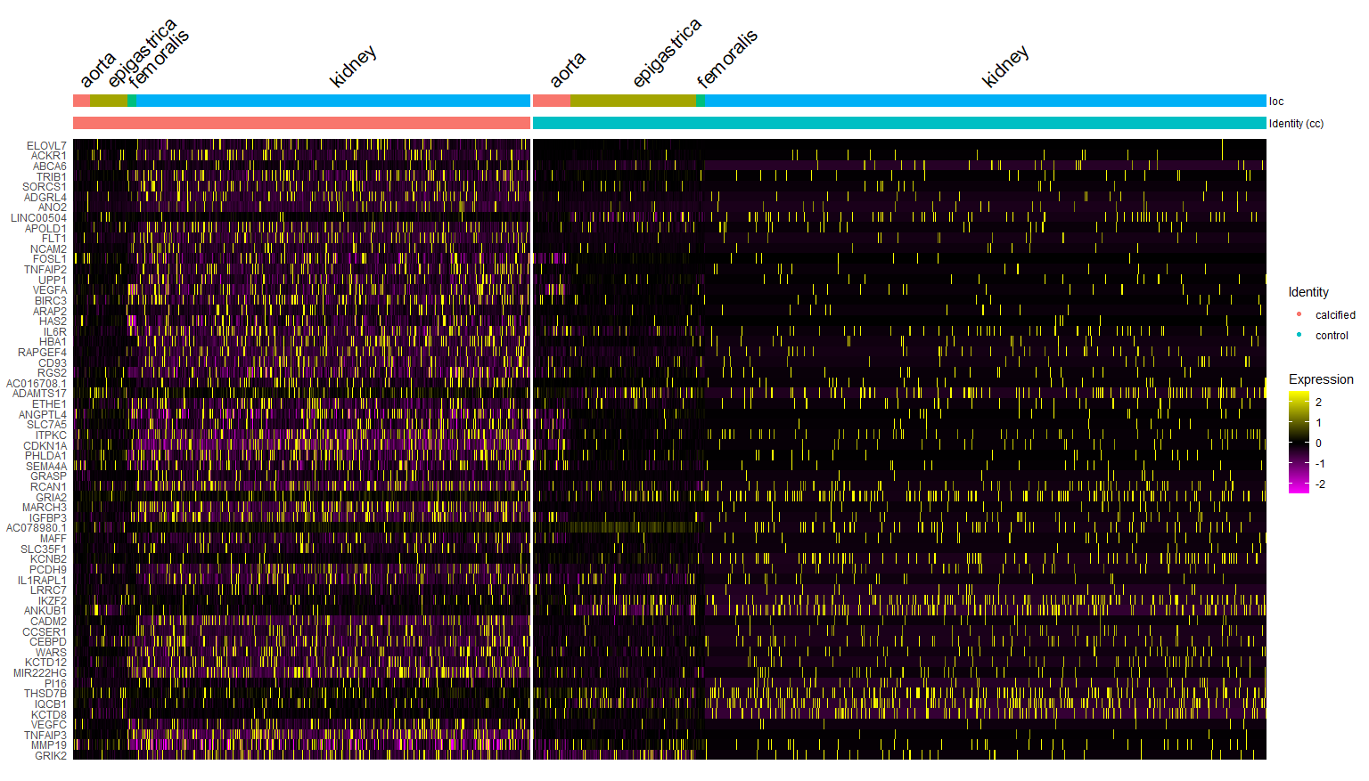
Top 60 DE genes (calcified vs control) – cluster 5

Slide 26
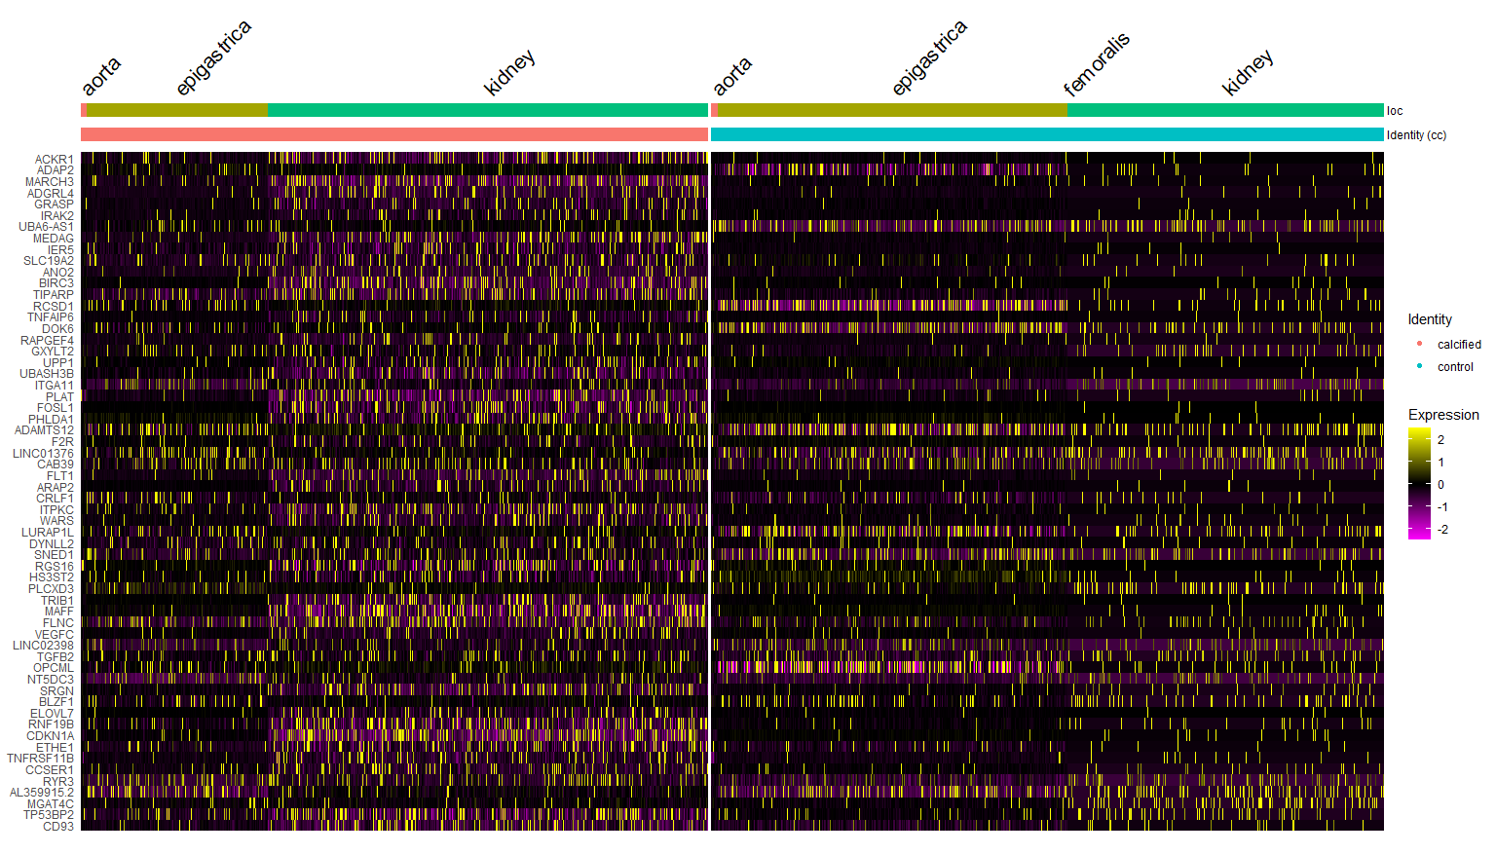
Top 60 DE genes (calcified vs control) – cluster 6

Slide 27
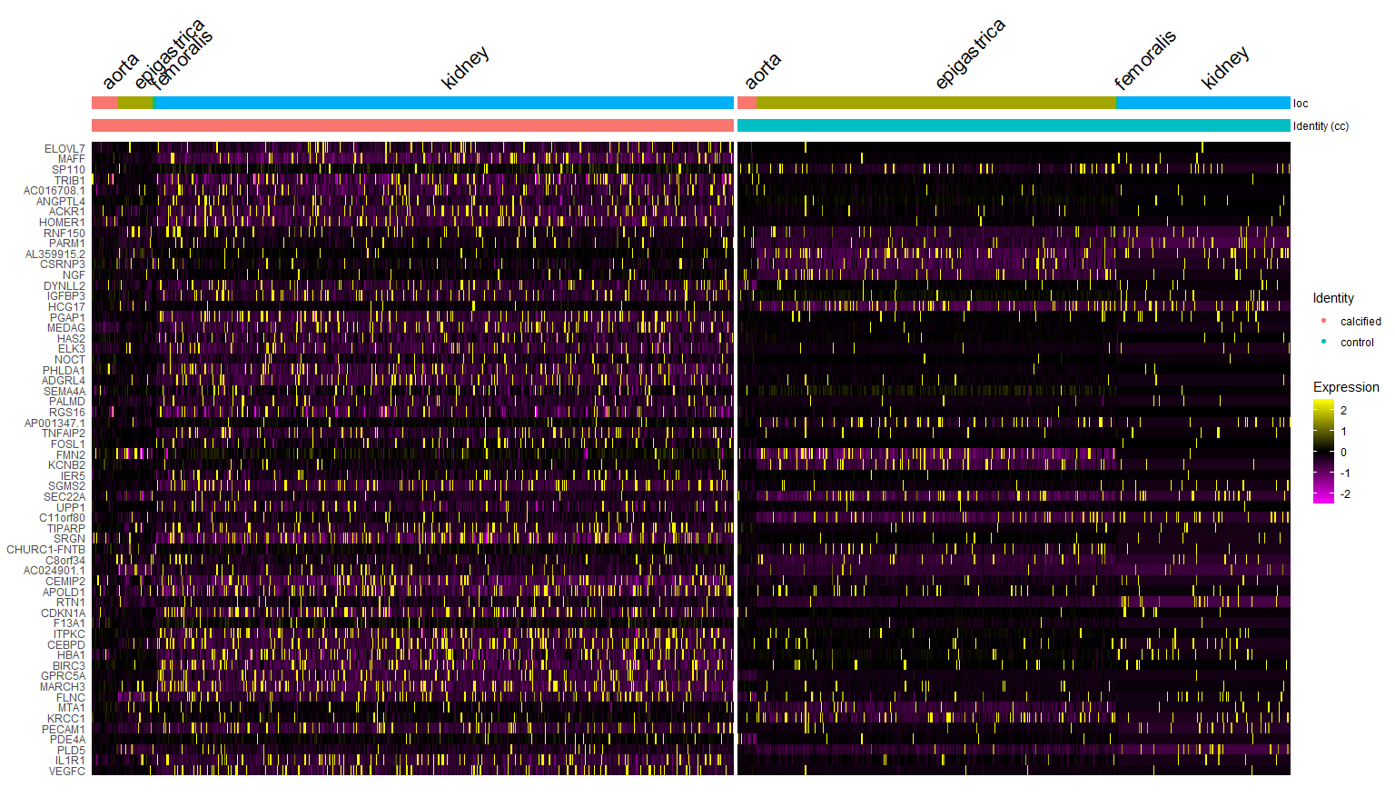
Top 60 DE genes (calcified vs control) – cluster 7

Slide 28
Kidney only

Slide 29
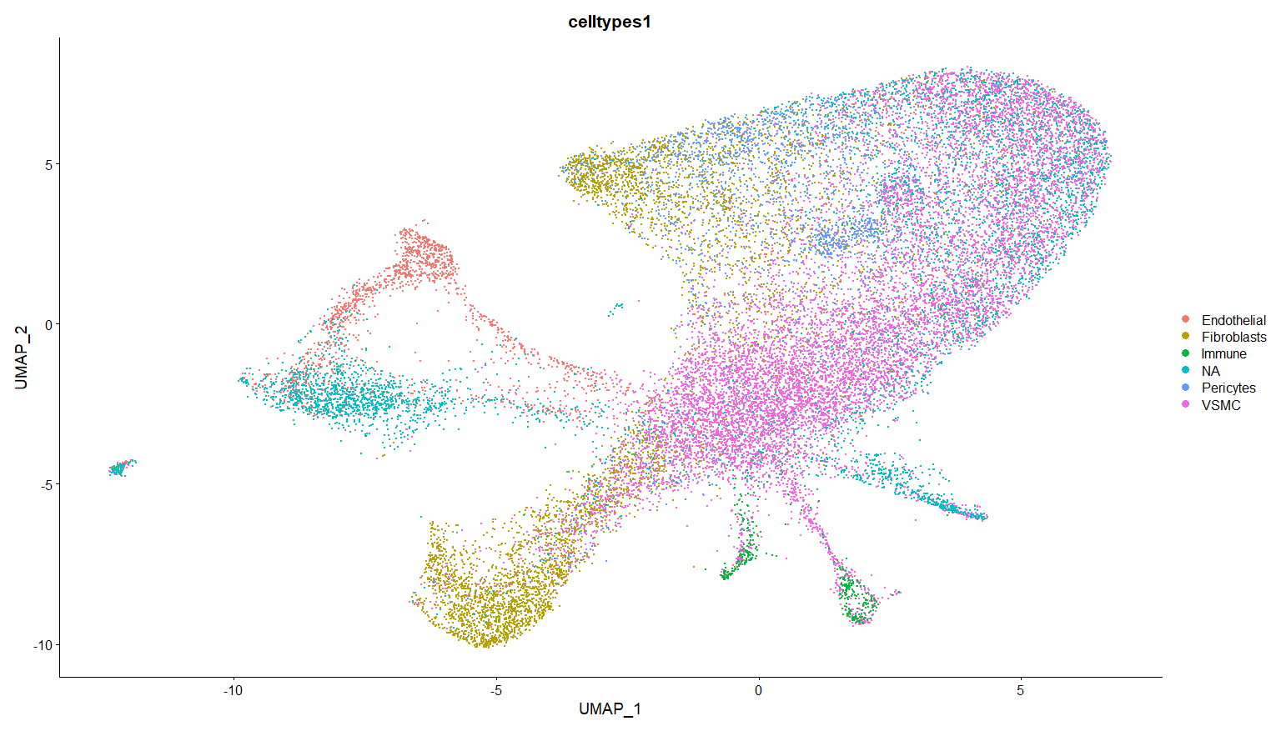
Reintegration – MH6 and MH7 only, showing labels generated per sample

Slide 30
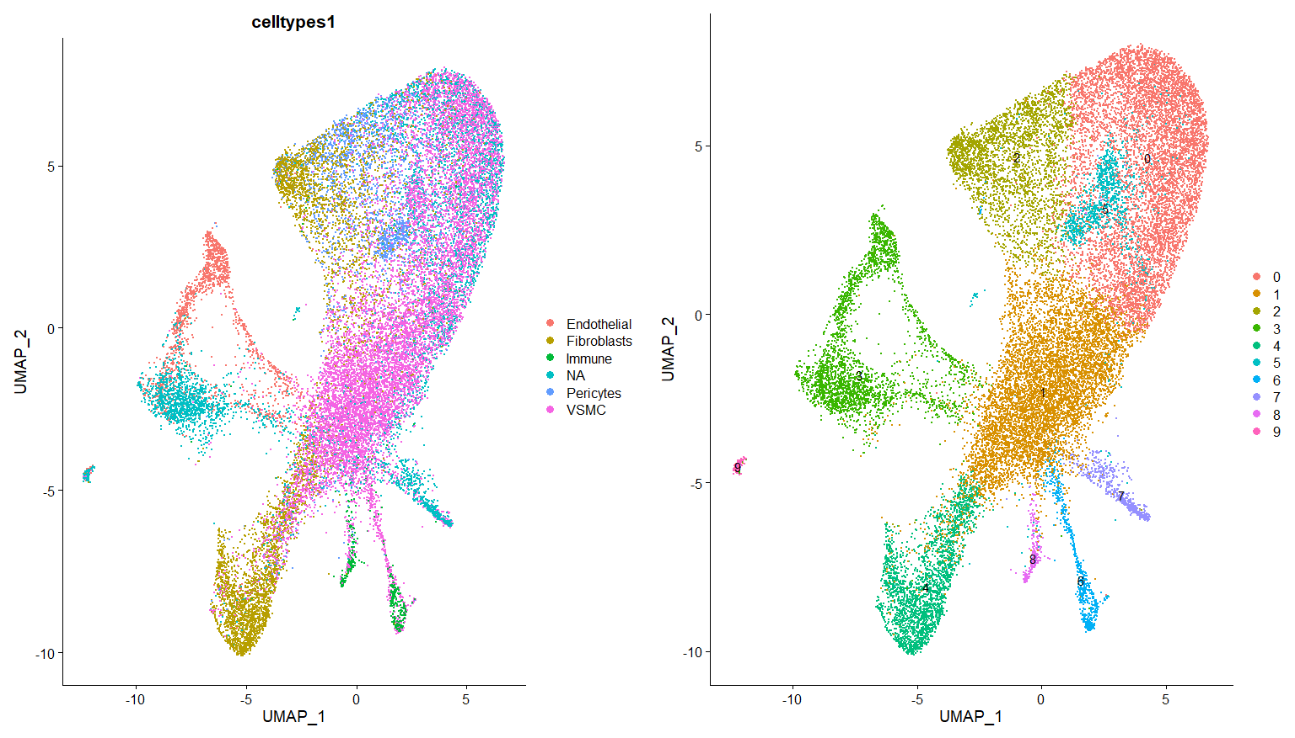
0-VSMC
1-VSMC/pericytes
2-Fibroblasts
3-Endothelial
4-Fibrolasts
5-Endothilial/pericytes
6-VSMC/immune
7-Unknown
8-VSMC/immune
9-NA

Slide 31
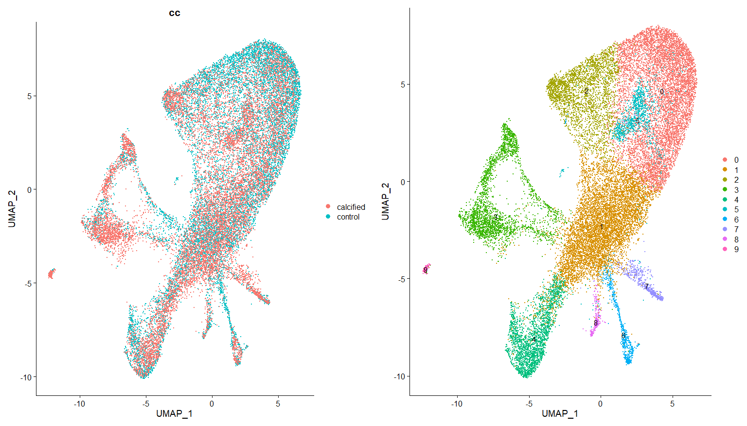

Slide 32
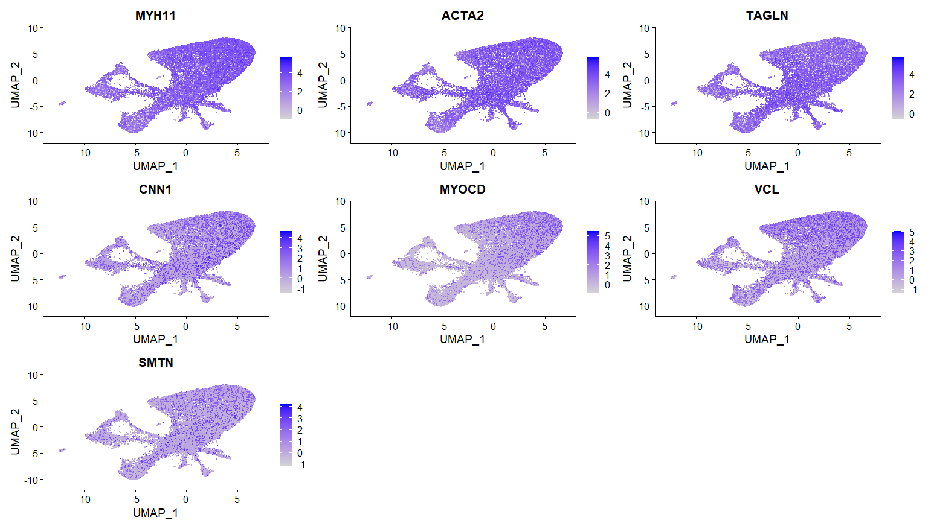
VSMC markers

Slide 33
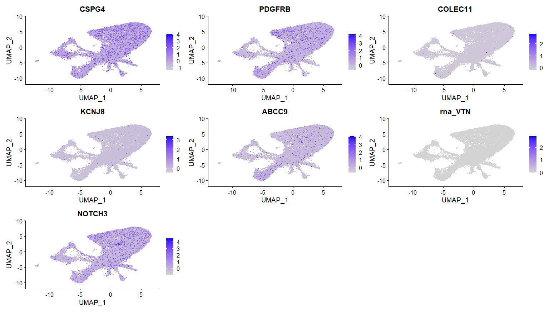
Pericyte markers

Slide 34
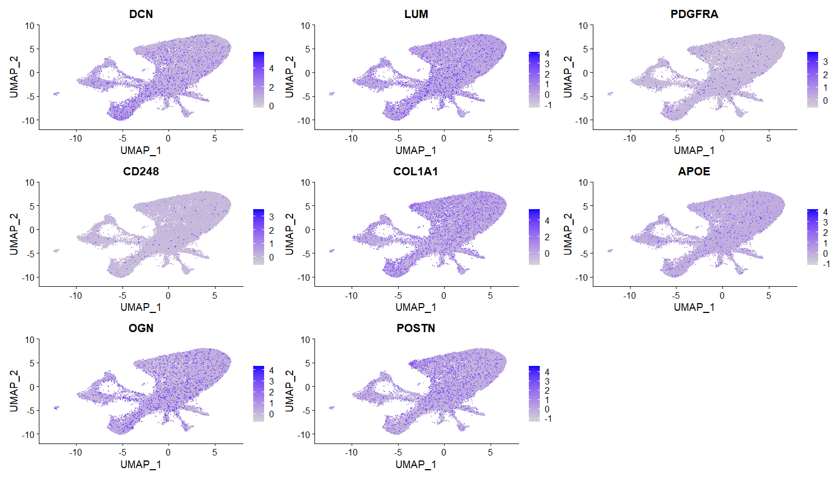
Fibroblast markers

Slide 35
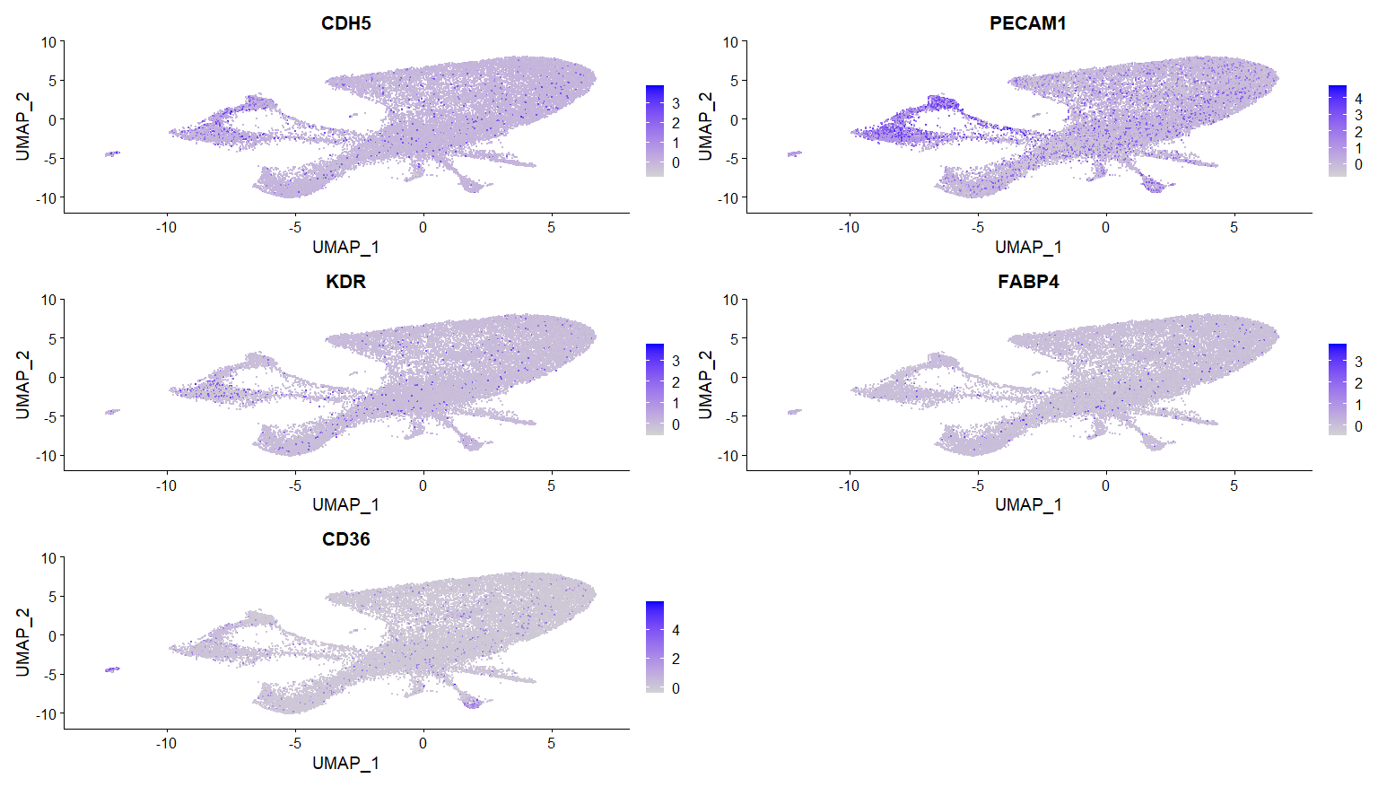
Endothelial markers

Slide 36
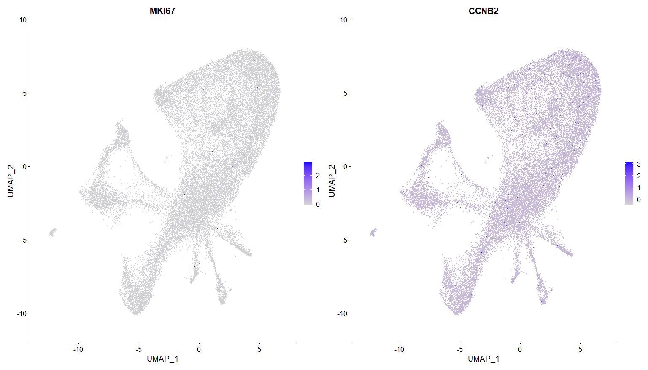
Cellcycle markers

Slide 37
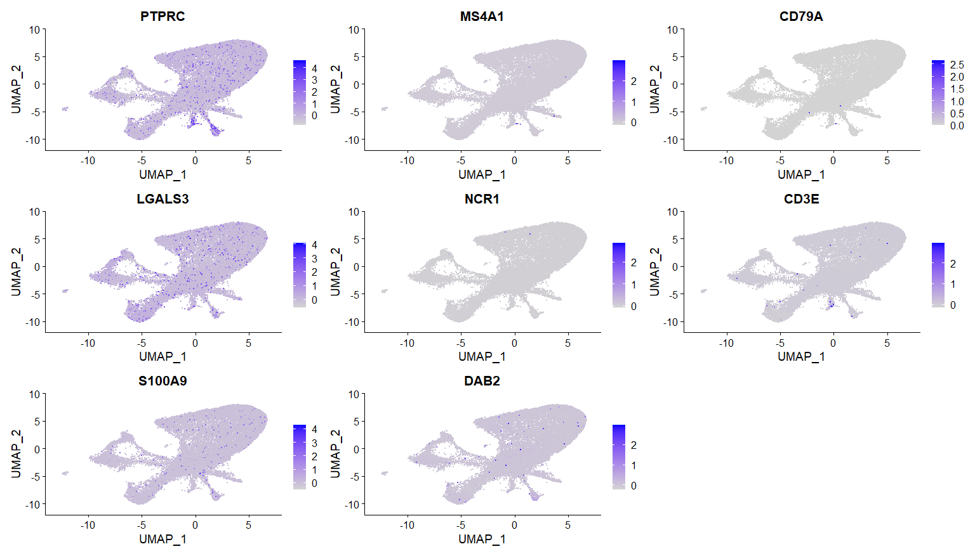
Immune markers

Slide 38
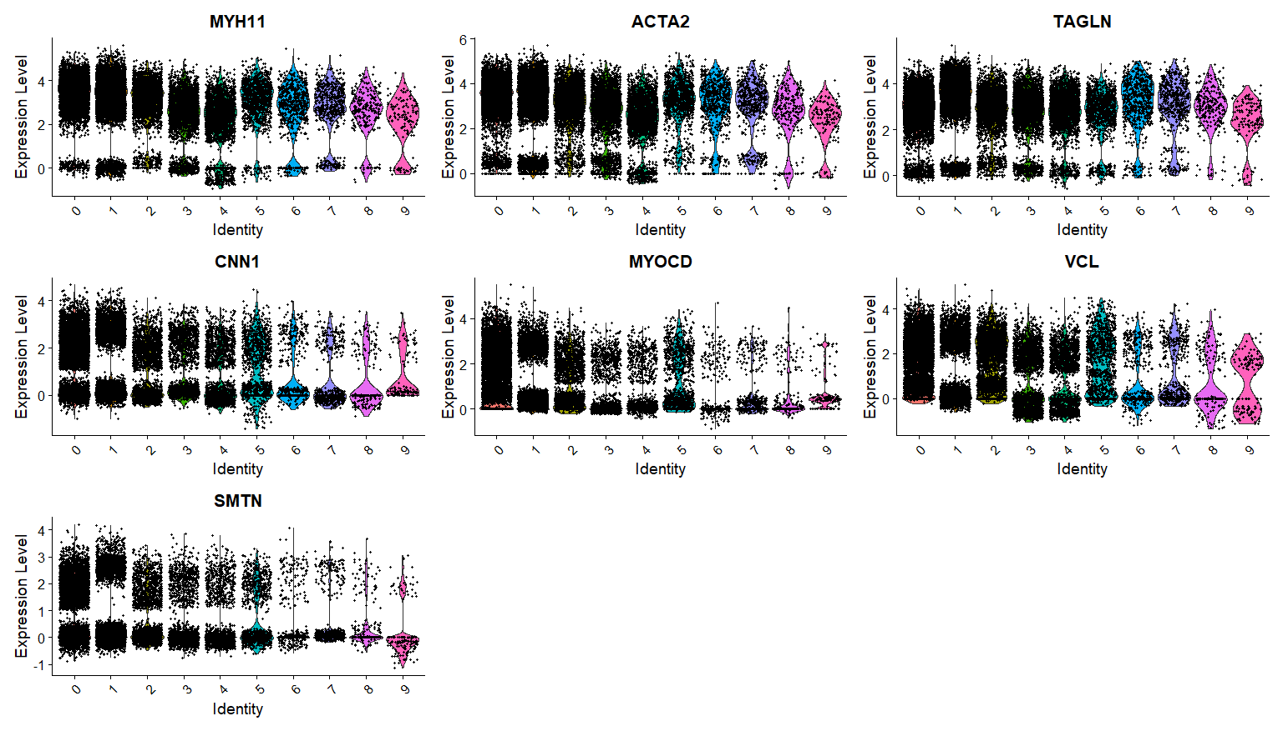
VSMC markers – 0,1?

Slide 39
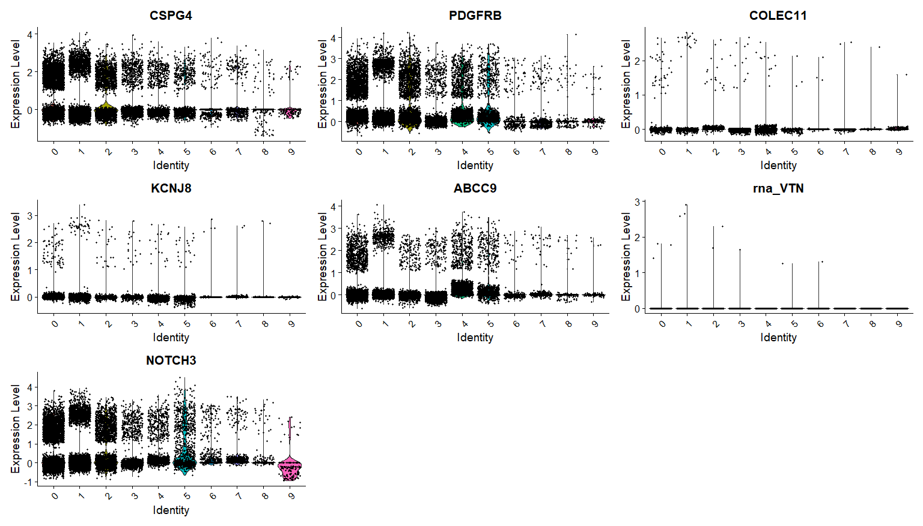
Pericyte markers – cluster 1,5

Slide 40
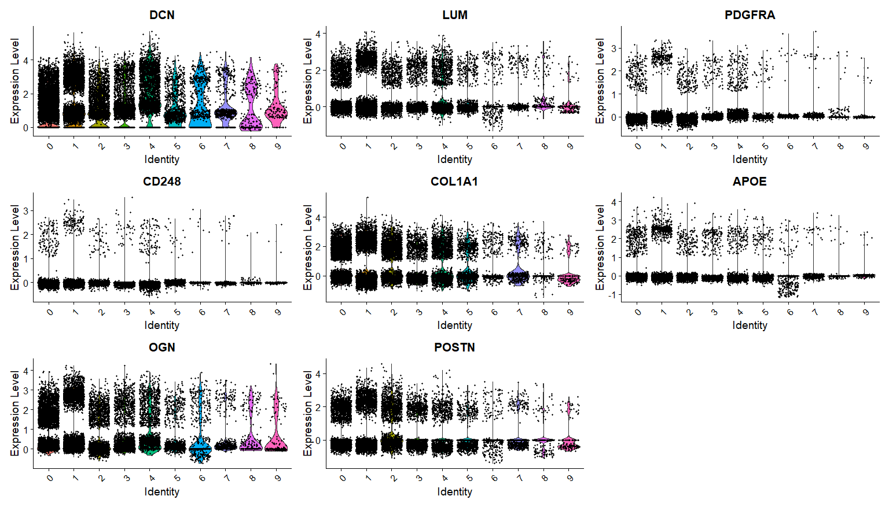
Fibroblast markers – cluster 4 (1?)

Slide 41
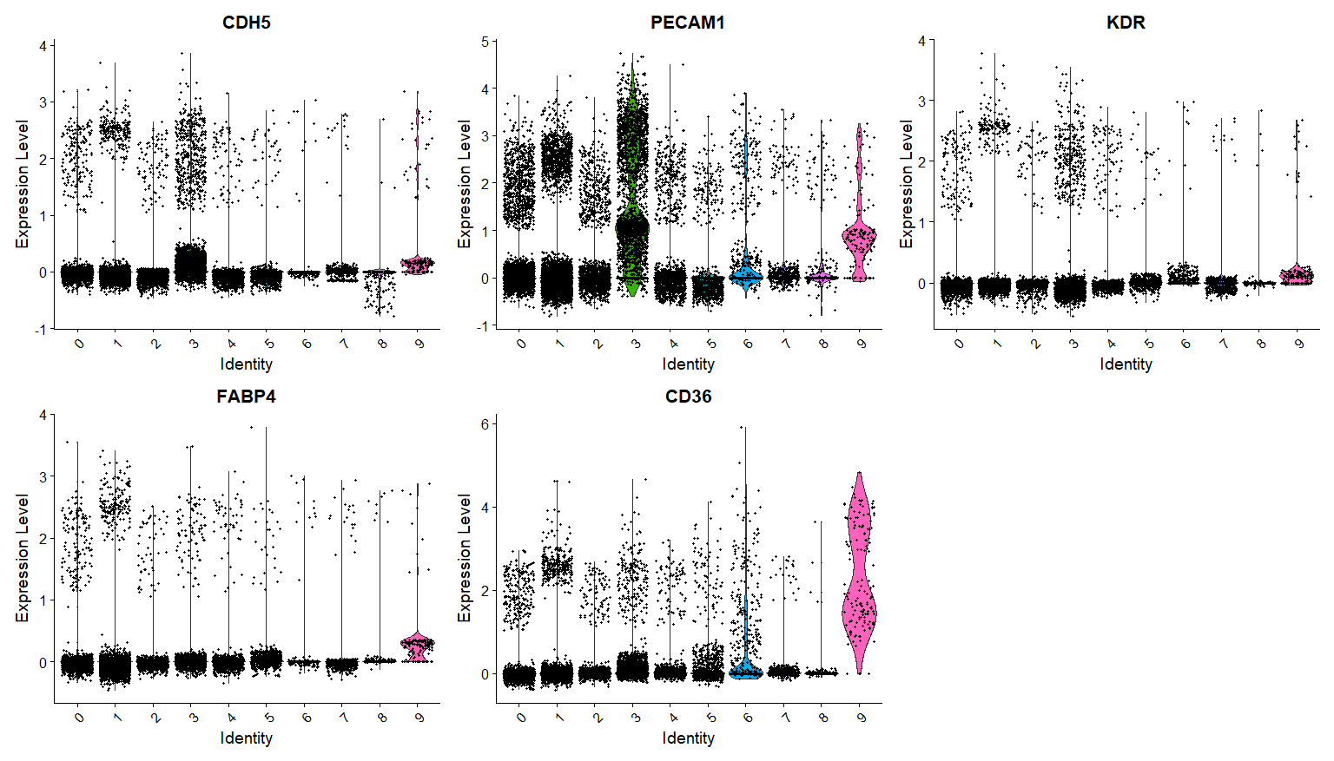
Endothelial markers – cluster 3, 9

Slide 42
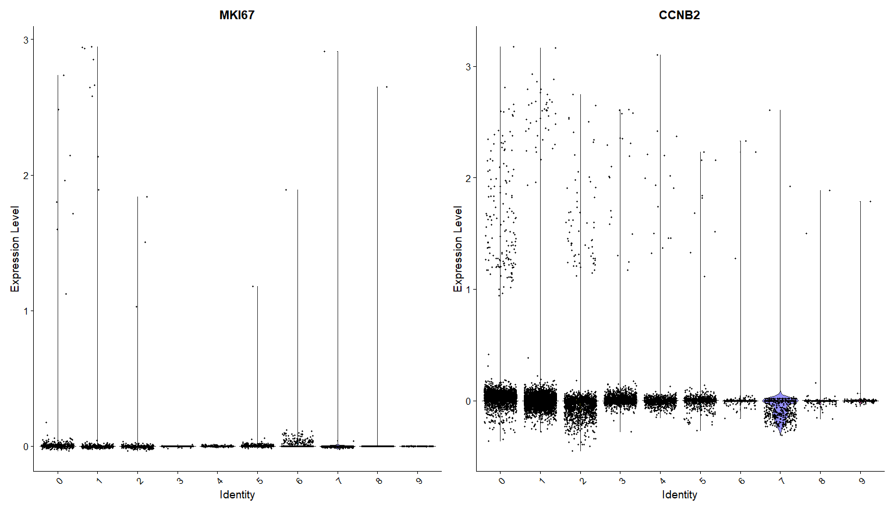
Cellcycle markers

Slide 43
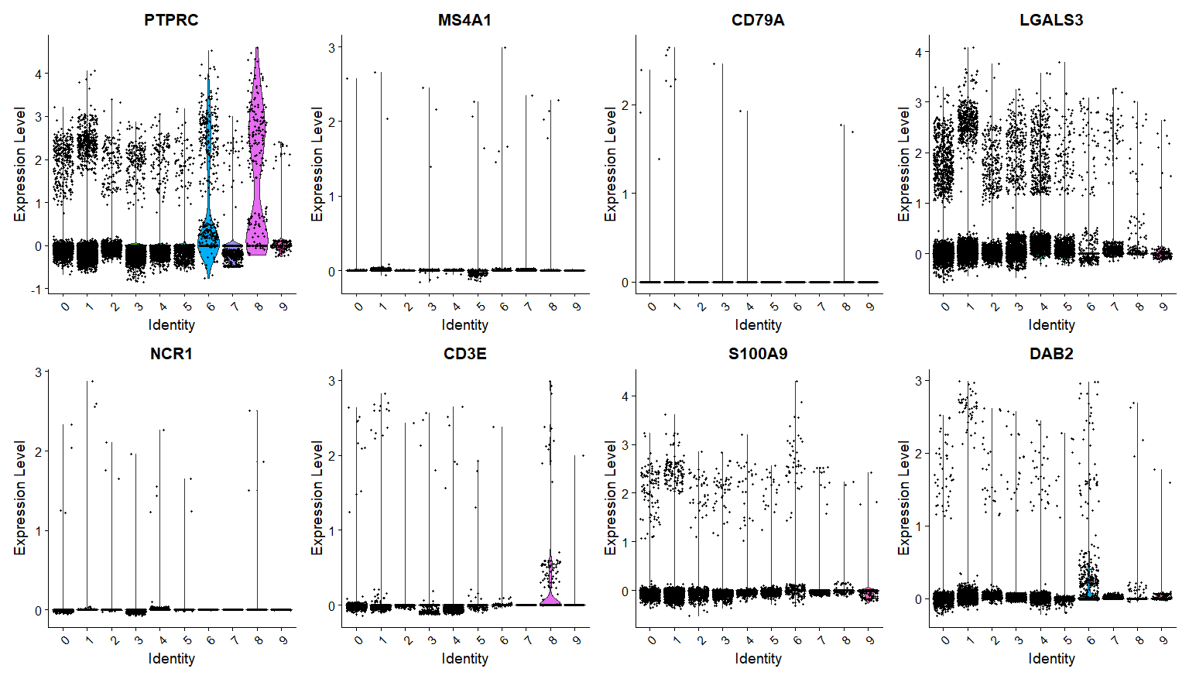
Immune markers – cluster 6,8

Slide 44
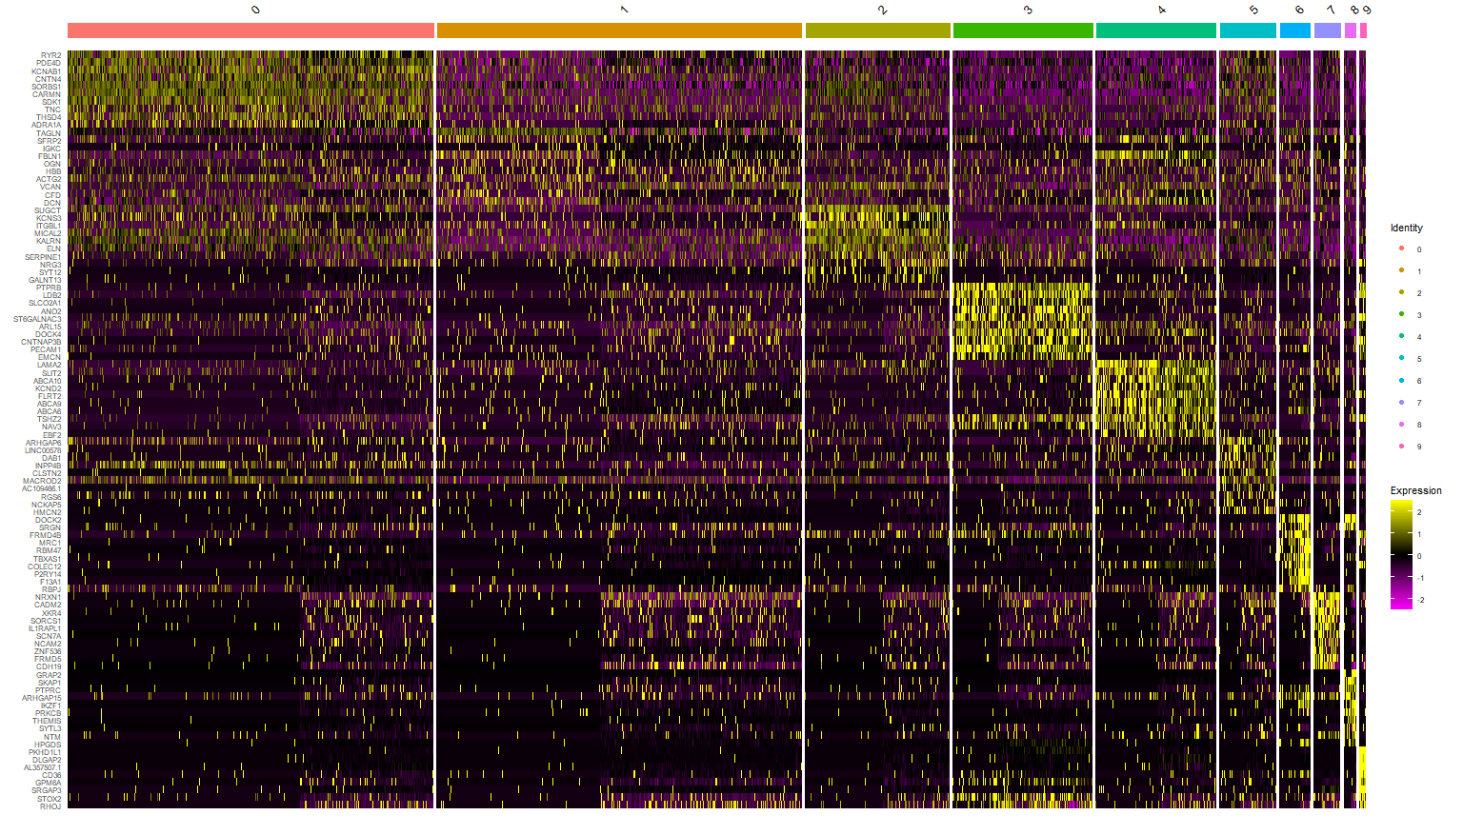

Slide 45
0-VSMC
1-Pericytes
2-Fibroblasts
3-Endothelial
4-Fibrolasts
5-Endothilial/pericytes
6-Immune
7-Unknown
8-T-cells
9-NA

